Slide 1
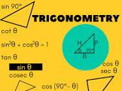
Trigonometry
Mrs. Parami Wattetenne
Lecturer (Probationary)
Department of Multidisciplinary Studies
Faculty of Technology
University of Ruhuna

Slide 2
What is Trigonometry?
Trigonometry is the branch of mathematics that deals with the measurement of sides and angles of trian- gles, and their relationship with each other. There are many applications in engineering where knowledge of trigonometry is needed.

Slide 3
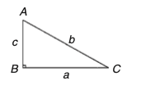
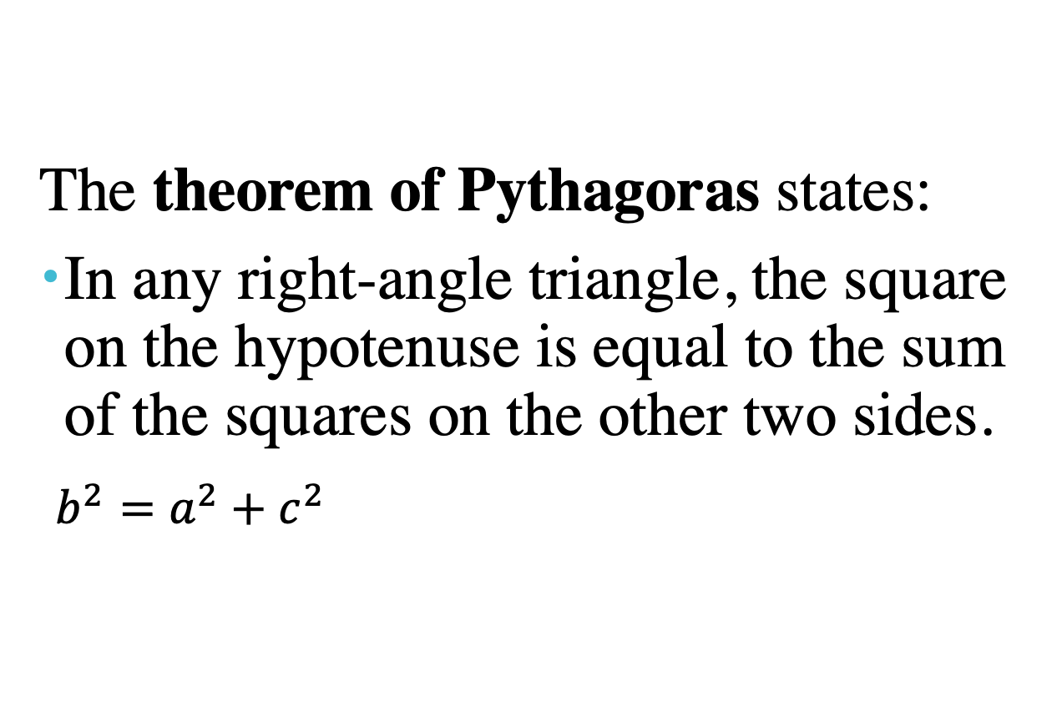
The theorem of Pythagoras
The theorem of Pythagoras states:
In any right-angle triangle, the square on the hypotenuse is equal to the sum of the squares on the other two sides.
$b^{2}=a^{2}+c^{2}$

Slide 4
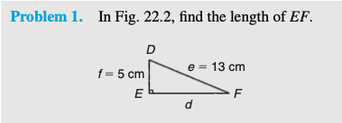
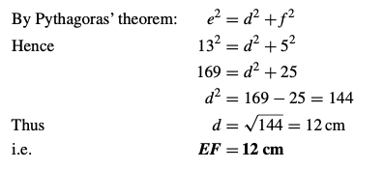
Exercise

Slide 5
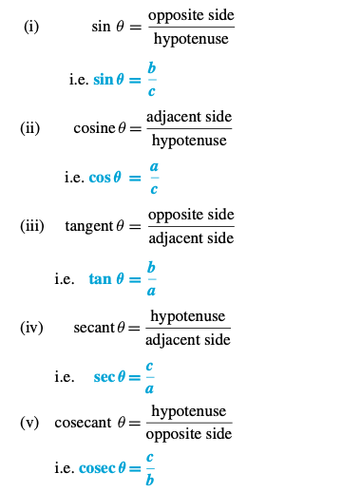
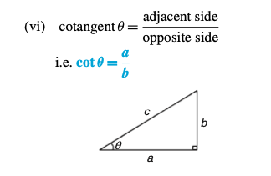
Trigonometric ratios of acute angles

Slide 6
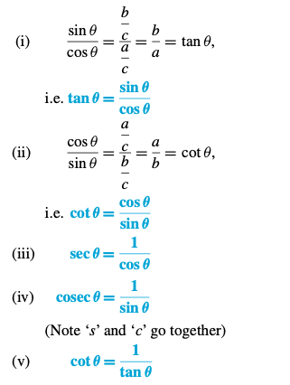
Trigonometric ratios of acute angles

Slide 7
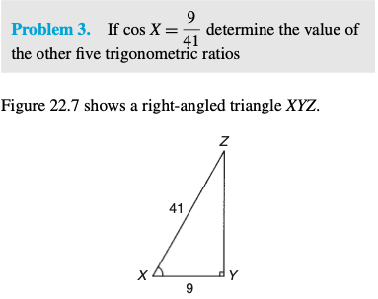
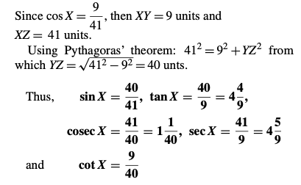
Exercise

Slide 8
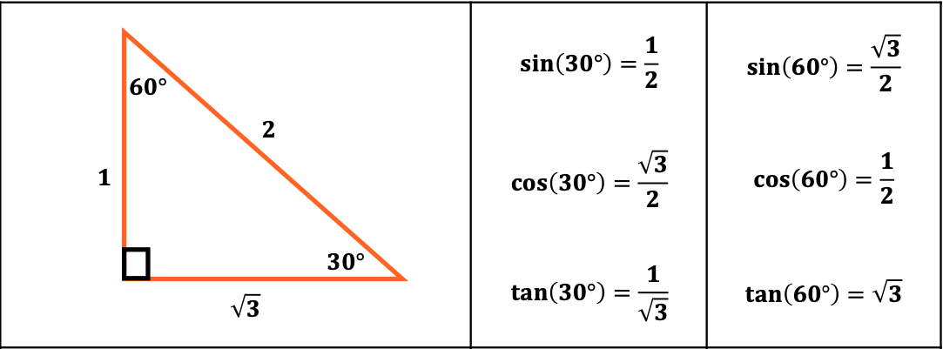
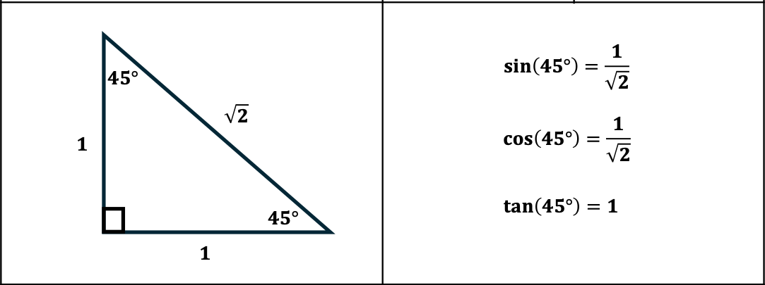
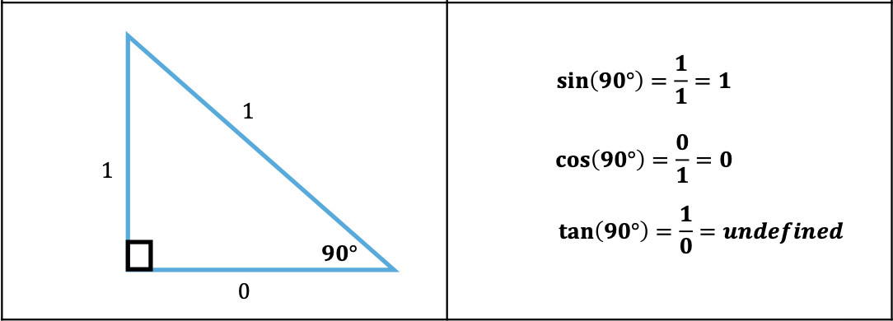
Special Angles

Slide 9
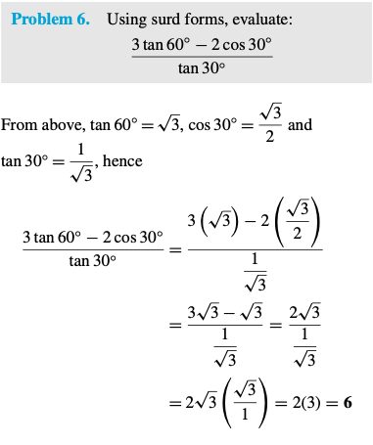
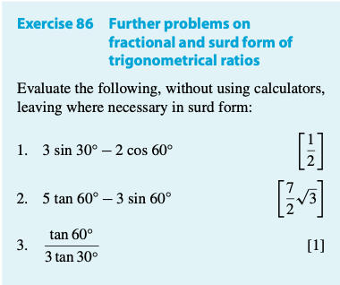
Exercise

Slide 10
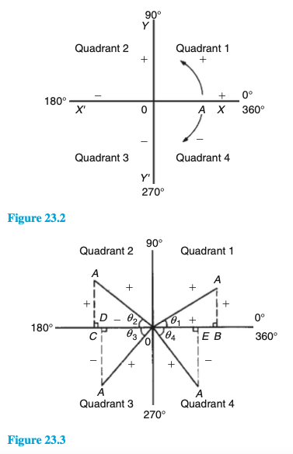
Angles of any magnitude
The following figure shows rectangular axes XX ′ and YY ′ inter- secting at origin 0. As with graphical work, measure- ments made to the right and above 0 are positive, while those to the left and downwards are negative. Let 0A be free to rotate about 0. By convention, when 0A moves anticlockwise angular measurement is considered pos- itive, and vice versa. Let 0A be rotated anticlockwise

Slide 11

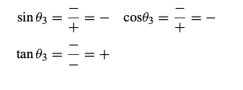
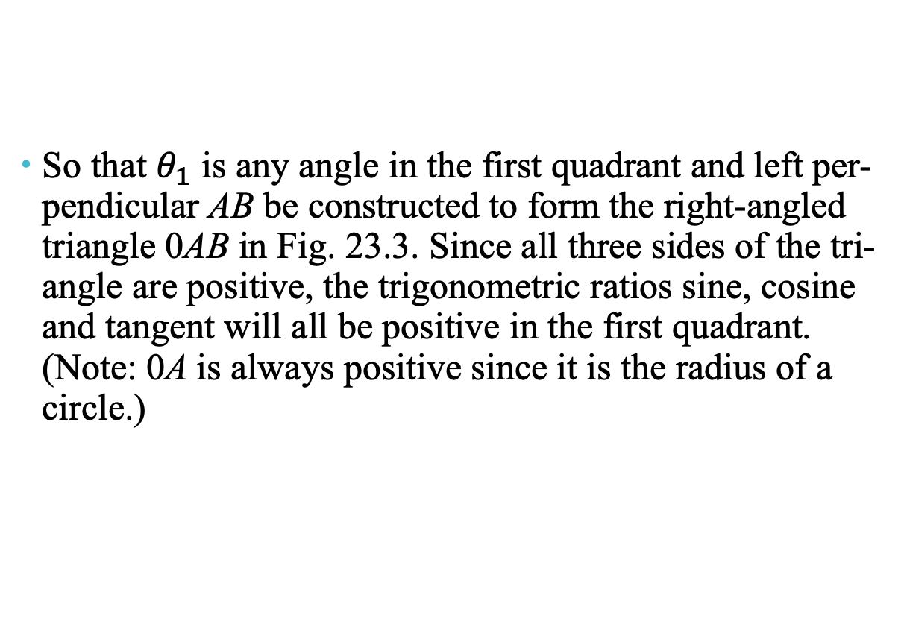
Angles of any magnitude
So that $θ_{1}$ is any angle in the first quadrant and left per- pendicular AB be constructed to form the right-angled triangle 0AB in Fig. 23.3. Since all three sides of the tri- angle are positive, the trigonometric ratios sine, cosine and tangent will all be positive in the first quadrant. (Note: 0A is always positive since it is the radius of a circle.)

Slide 12
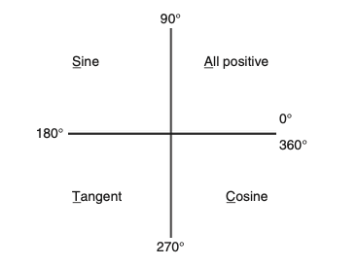
Angles of any magnitude
The above results are summarized in the following figure.
The letters underlined spell the word CAST when starting in the fourth quadrant and moving in an anticlockwise direction.

Slide 13
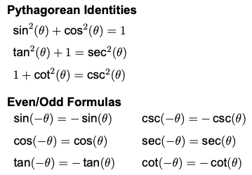
Special Formulas

Slide 14
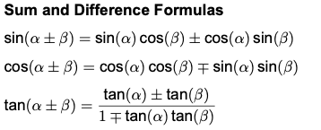
Addition and subtraction formulas for Trigonometric functions

Slide 15
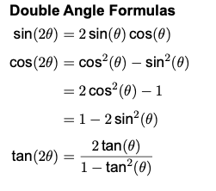

Trigonometric ratios of $2θ$ those of $θ$ ,

Slide 16
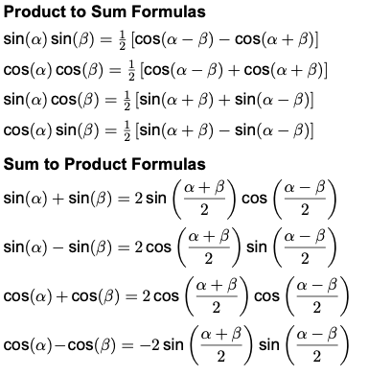
Transformations of sums into products and products into sums.

Slide 17
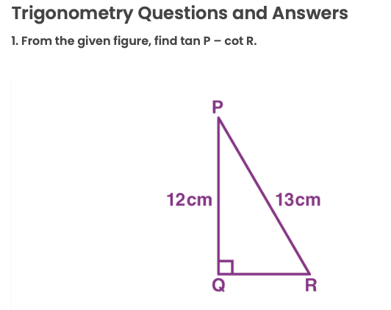
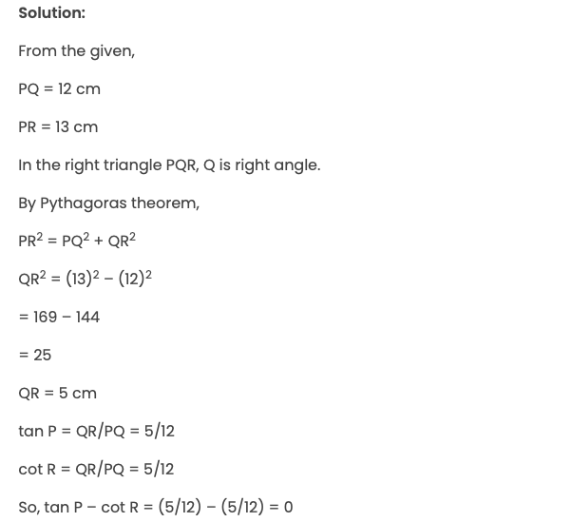
Questions

Slide 18
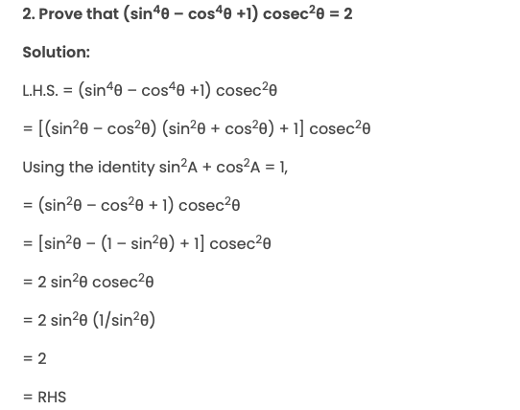
Questions

Slide 19
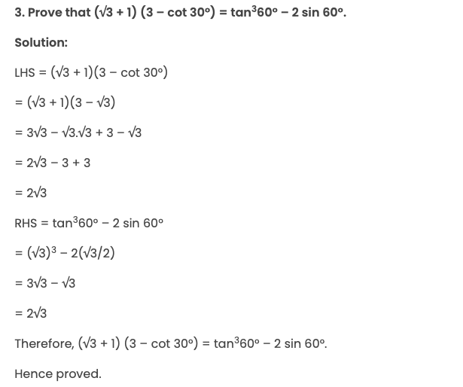
Questions

